Slide 1
Higher Standen Park, Clitheroe
23rd November 2016

Slide 2
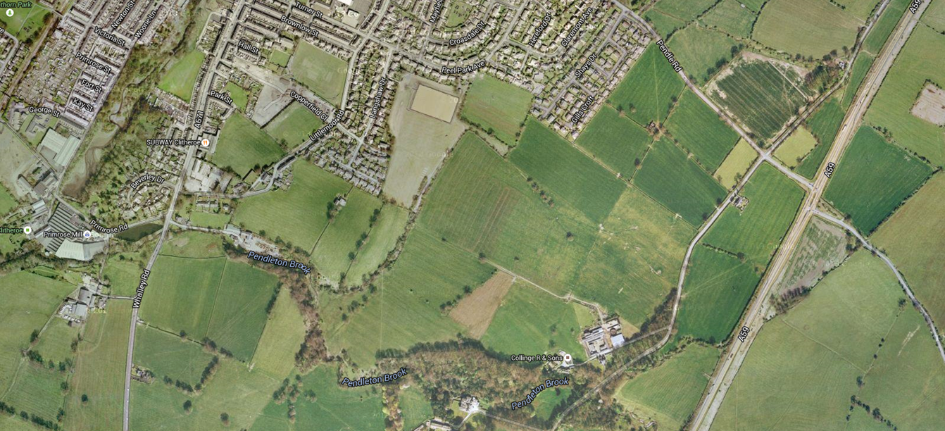
Site Aerial Photo

Slide 3
Full Development Plan

Slide 4
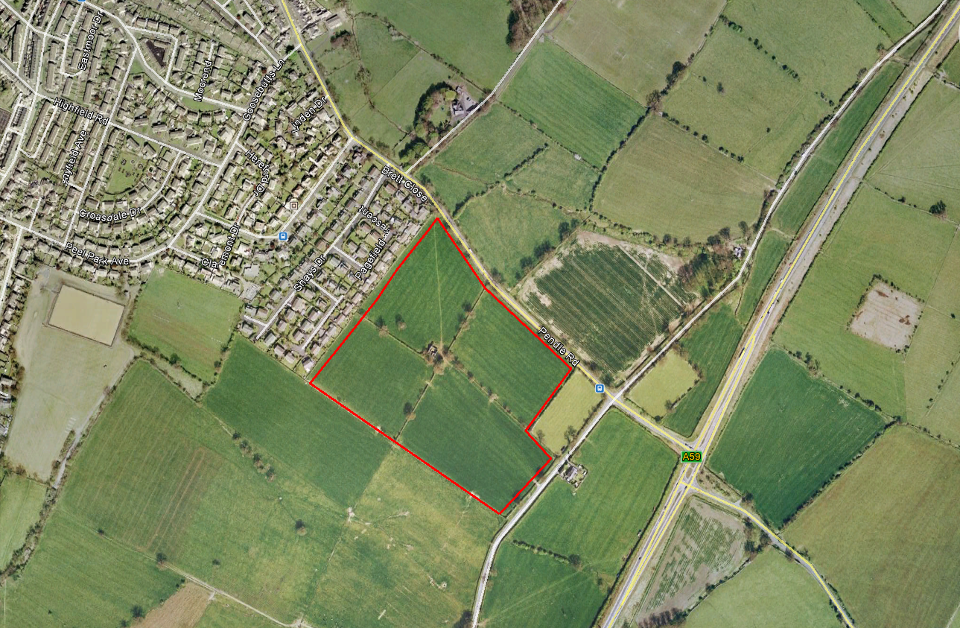
Phase 1 Aerial Photo

Slide 5
Phase 1 Layout

Slide 6
Key Points
Phase 1 - 228 houses
Largest strategic housing site within Ribble Valley BC
30% Affordable housing - 68 homes
Site has Outline Planning Permission for a mixed use development
Approved uses are 1040 houses (affordable 312 homes), local retail, B1 office use, retirement housing, pub/ restaurant and land provision for a Primary School
25% of affordable to be built to LTH standards and occupied by persons over 55 years of age
New roundabout on the A59 and at site entrance with Pendle Road
7.5% of all market dwellings within each Phase to be built to LTH standards and occupied by persons over 55 years of age
Commuted sum payments for sport and leisure, transport, education and travel plan
S106 states 60% two bedroom homes and 40% three bedroom homes

Slide 7
Next Steps and Timescales
Next Steps
Timescales
Affordable tenders received
Site Start – February 2017
Review tenders and viability
First market home legal completion – Summer 2017
Review mix and tenure with RVBC
First affordable homes – Spring 2018
Phase 1 build period - 4 years

Slide 8
Site Entrance Image

